Slide 1
Jan 29

Slide 2

Training result (fjc only, 30 constituents)

Slide 3
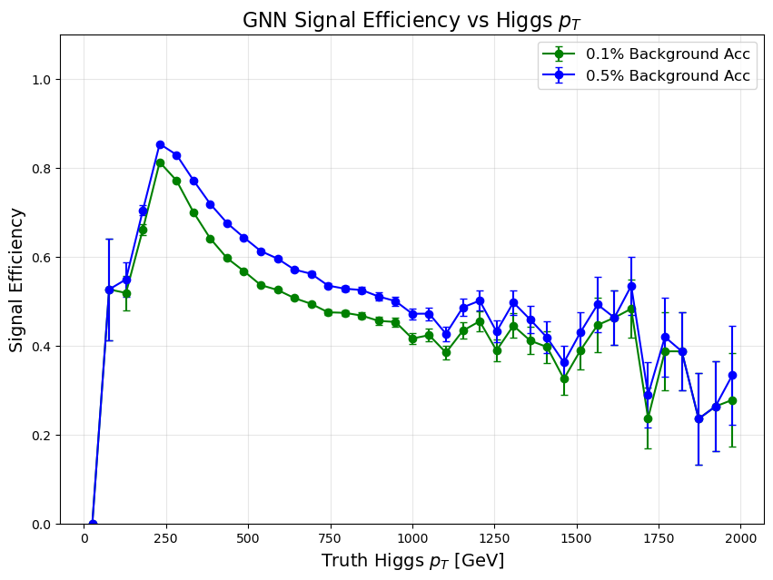

Slide 4
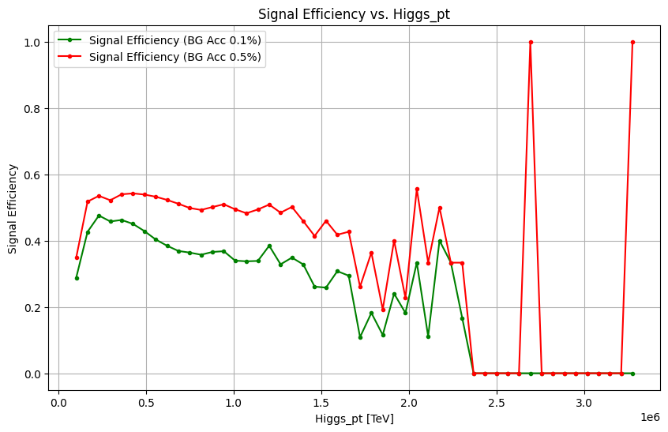

DNN baseline results from before:

Slide 5
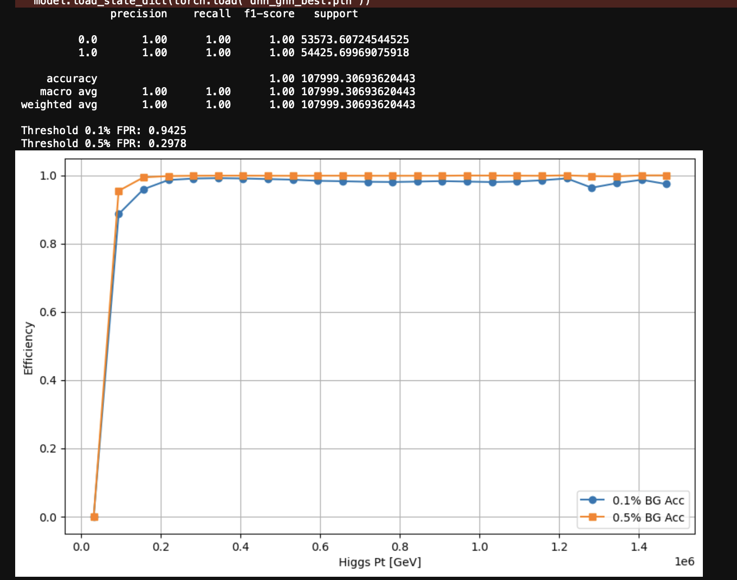
Combined:

Slide 6


